Slide 1

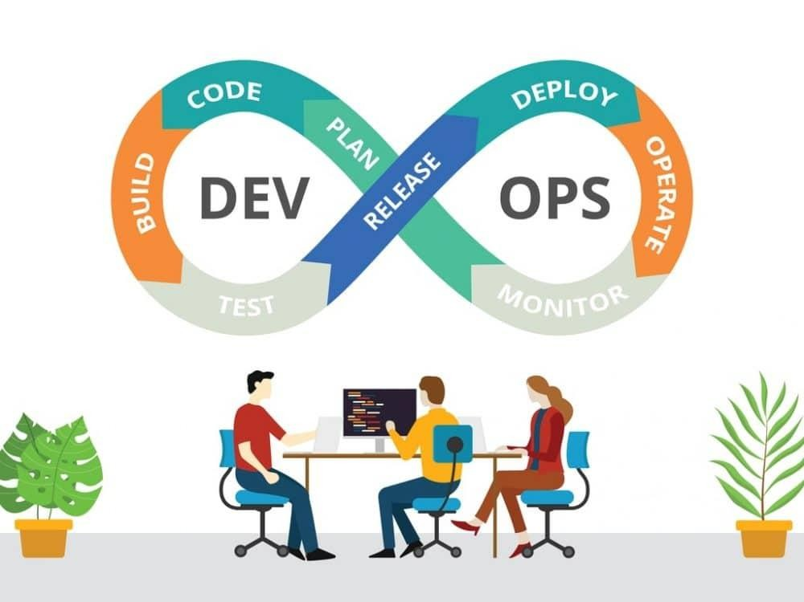

DEVOPS WITH AWS: COMPLETE CI/CD

Slide 2
Contents of The Session
What is DevOps?
Beneﬁts of DevOps?
DevOps Practices
How to do DevOps with AWS?
CI/CD Demo Using AWS CodePipeline + CodeCommit
· CodeBuild + AWS ECS
Whizlabs Hands-On labs Demo
QnA
Exciting Quiz

Slide 3
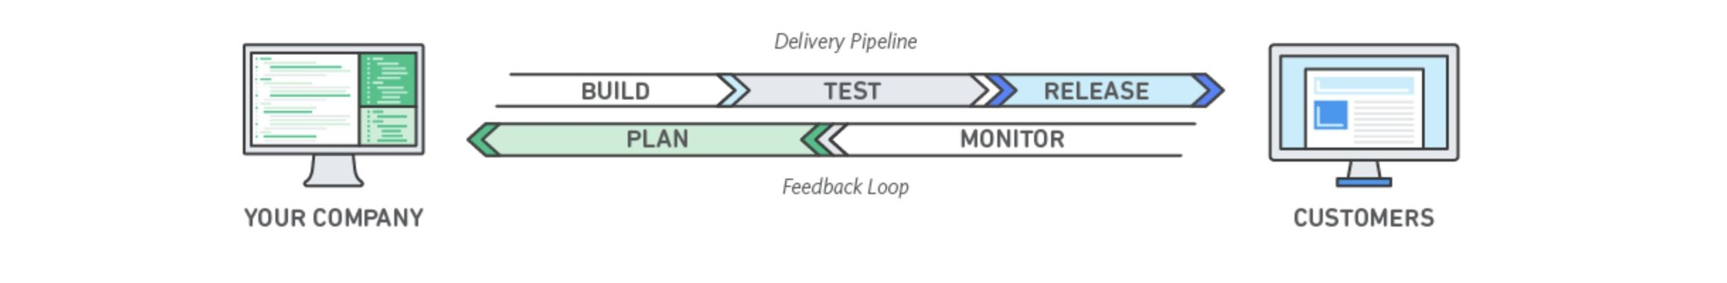
What is DevOps
DevOps is the combination of cultural philosophies, practices, and tools that increases an organization’s ability to deliver applications and services at high velocity: evolving and improving products at a faster pace than organizations using traditional software development and infrastructure management processes. This speed enables organizations to better serve their customers and compete more eﬀectively in the market.

Slide 4
Beneﬁts of DevOps
Speed : Move at high velocity so you can innovate for customers faster, adapt to changing markets better, and grow more eﬃcient at driving business results. The DevOps model enables your developers and operations teams to achieve these results. For example, microservices and continuous delivery let teams take ownership of services and then release updates to them quicker.
Rapid Delivery: Increase the frequency and pace of releases so you can innovate and improve your product faster. The quicker you can release new features and ﬁx bugs, the faster you can respond to your customers’ needs and build competitive advantage. Continuous integration and continuous delivery are practices that automate the software release process, from build to deploy.
Reliability: Ensure the quality of application updates and infrastructure changes so you can reliably deliver at a more rapid pace while maintaining a positive experience for end users. Use practices like continuous integration and continuous delivery to test that each change is functional and safe. Monitoring and logging practices help you stay informed of performance in real-time.
Scale: Operate and manage your infrastructure and development processes at scale. Automation and consistency help you manage complex or changing systems eﬃciently and with reduced risk. For example, infrastructure as code helps you manage your development, testing, and production environments in a repeatable and more eﬃcient manner.
Improved Collaboration: Build more eﬀective teams under a DevOps cultural model, which emphasizes values such as ownership and accountability. Developers and operations teams collaborate closely, share many responsibilities, and combine their workﬂows. This reduces ineﬃciencies and saves time (e.g. reduced handover periods between developers and operations, writing code that takes into account the environment in which it is run).
Security: Move quickly while retaining control and preserving compliance. You can adopt a DevOps model without sacriﬁcing security by using automated compliance policies, ﬁne-grained controls, and conﬁguration management techniques. For example, using infrastructure as code and policy as code, you can deﬁne and then track compliance at scale.

Slide 5
DevOps Practices
Continuous Integration: Continuous integration is a software development practice where developers regularly merge their code changes into a central repository, after which automated builds and tests are run. The key goals of continuous integration are to ﬁnd and address bugs quicker, improve software quality, and reduce the time it takes to validate and release new software updates.
Continuous Delivery: Continuous delivery is a software development practice where code changes are automatically built, tested, and prepared for a release to production. It expands upon continuous integration by deploying all code changes to a testing environment and/or a production environment after the build stage. When continuous delivery is implemented properly, developers will always have a deployment-ready build artifact that has passed through a standardized test process.
Microservices: The microservices architecture is a design approach to build a single application as a set of small services. Each service runs in its own process and communicates with other services through a well-deﬁned interface using a lightweight mechanism, typically an HTTP-based application programming interface (API). Microservices are built around business capabilities; each service is scoped to a single purpose. You can use diﬀerent frameworks or programming languages to write microservices and deploy them independently, as a single service, or as a group of services.
Infrastructure as Code: Infrastructure as code is a practice in which infrastructure is provisioned and managed using code and software development techniques, such as version control and continuous integration. The cloud’s API-driven model enables developers and system administrators to interact with infrastructure programmatically, and at scale, instead of needing to manually set up and conﬁgure resources. Thus, engineers can interface with infrastructure using code-based tools and treat infrastructure in a manner similar to how they treat application code. Because they are deﬁned by code, infrastructure and servers can quickly be deployed using standardized patterns, updated with the latest patches and versions, or duplicated in repeatable ways.

Slide 6
DevOps Practices
Monitoring and Logging: Organizations monitor metrics and logs to see how application and infrastructure performance impacts the experience of their product’s end user. By capturing, categorizing, and then analyzing data and logs generated by applications and infrastructure, organizations understand how changes or updates impact users, shedding insights into the root causes of problems or unexpected changes. Active monitoring becomes increasingly important as services must be available 24/7 and as application and infrastructure update frequency increases. Creating alerts or performing real-time analysis of this data also helps organizations more proactively monitor their services.
Communication and Collaboration: Increased communication and collaboration in an organization is one of the key cultural aspects of DevOps. The use of DevOps tooling and automation of the software delivery process establishes collaboration by physically bringing together the workﬂows and responsibilities of development and operations. Building on top of that, these teams set strong cultural norms around information sharing and facilitating communication through the use of chat applications, issue or project tracking systems, and wikis. This helps speed up communication across developers, operations, and even other teams like marketing or sales, allowing all parts of the organization to align more closely on goals and projects.

Slide 7
How to do DevOps With AWS
AWS providing us below DevOps tools and services:
Continuous Integration and Continuous Delivery
AWS CodePipeline: AWS CodePipeline is a continuous integration and continuous delivery service for fast and reliable application and infrastructure updates. CodePipeline builds, tests, and deploys your code every time there is a code change, based on the release process models you deﬁne. This enables you to rapidly and reliably deliver features and updates.
AWS CodeBuild: AWS CodeBuild is a fully managed build service that compiles source code, runs tests, and produces software packages that are ready to deploy. With CodeBuild, you don’t need to provision, manage, and scale your own build servers. CodeBuild scales continuously and processes multiple builds concurrently, so your builds are not left waiting in a queue.
AWS CodeDeploy: AWS CodeDeploy automates code deployments to any instance, including Amazon EC2 instances and on-premises servers. AWS CodeDeploy makes it easier for you to rapidly release new features, helps you avoid downtime during application deployment, and handles the complexity of updating your applications.
AWS CodeStar: AWS CodeStar enables you to quickly develop, build, and deploy applications on AWS. AWS CodeStar provides a uniﬁed user interface, enabling you to easily manage your software development activities in one place. With AWS CodeStar, you can set up your entire continuous delivery toolchain in minutes, allowing you to start releasing code faster.

Slide 8
How to do DevOps With AWS
Microservices
Amazon Elastic Container Service: Amazon Elastic Container Service (ECS) is a highly scalable, high performance container management service that supports Docker containers and allows you to easily run applications on a managed cluster of Amazon EC2 instances.
AWS Lambda: AWS Lambda lets you run code without provisioning or managing servers. With Lambda, you can run code for virtually any type of application or backend service - all with zero administration. Just upload your code and Lambda takes care of everything required to run and scale your code with high availability.
Infrastructure as Code
AWS CloudFormation: AWS CloudFormation gives developers and systems administrators an easy way to create and manage a collection of related AWS resources, provisioning and updating them in an orderly and predictable fashion. You can use AWS CloudFormation’s sample templates or create your own templates.
AWS OpsWorks: AWS OpsWorks is a conﬁguration management service that uses Chef, an automation platform that treats server conﬁgurations as code. OpsWorks uses Chef to automate how servers are conﬁgured, deployed, and managed across your Amazon Elastic Compute Cloud (Amazon EC2) instances or on-premises compute environments. OpsWorks has two oﬀerings, AWS Opsworks for Chef Automate, and AWS OpsWorks Stacks.

Slide 9
How to do DevOps With AWS
AWS Systems Manager: AWS Systems Manager is a management service that helps you automatically collect software inventory, apply OS patches, create system images, and conﬁgure Windows and Linux operating systems. These capabilities help you deﬁne and track system conﬁgurations, prevent drift, and maintain software compliance of your EC2 and on-premises conﬁgurations.
AWS Conﬁg: AWS Conﬁg is a fully managed service that provides you with an AWS resource inventory, conﬁguration history, and conﬁguration change notiﬁcations to enable security and governance. Conﬁg Rules enables you to create rules that automatically check the conﬁguration of AWS resources recorded by AWS Conﬁg.
Monitoring and Logging
Amazon CloudWatch: Amazon CloudWatch is a monitoring service for AWS cloud resources and the applications you run on AWS. You can use Amazon CloudWatch to collect and track metrics, collect and monitor log ﬁles, set alarms, and automatically react to changes in your AWS resources.
AWS X-Ray: AWS X-Ray helps developers analyze and debug production, distributed applications, such as those built using a microservices architecture. With X-Ray, you can understand how your application and its underlying services are performing to identify and troubleshoot the root cause of performance issues and errors.
AWS CloudTrail: AWS CloudTrail is a web service that records AWS API calls for your account and delivers log ﬁles to you. The recorded information includes the identity of the API caller, the time of the API call, the source IP address of the API caller, the request parameters, and the response elements returned by the AWS service.

Slide 10
How to do DevOps With AWS
Platform as a Service
AWS Elastic Beanstalk: AWS Elastic Beanstalk is an easy-to-use service for deploying and scaling web applications and services developed with Java, .NET, PHP, Node.js, Python, Ruby, Go, and Docker on familiar servers such as Apache, Nginx, Passenger, and IIS.
You can simply upload your code and Elastic Beanstalk automatically handles the deployment, from capacity provisioning, load balancing,
auto-scaling to application health monitoring. At the same time, you retain full control over the AWS resources powering your application and can access the underlying resources at any time.
Version Control
AWS CodeCommit: AWS CodeCommit is a fully-managed source control service that makes it easy for companies to host secure and highly scalable private Git repositories. You can use CodeCommit to securely store anything from source code to binaries, and it works seamlessly with your existing Git tools.

Slide 11
CI/CD Demo using
AWS CodePipeline
+
AWS CodeCommit
+
AWS CodeBuild
+ AWS ECS

Slide 12
Build Docker Image using Dockerﬁle
Run Below command from
Project Directory to build the image Before that install docker: https://docs.docker.com/engine/install/ To Make Docker Build
docker image build -t <image_name>:tag . (“.” refer to current directory)
e.g.
docker image build -t cicd-demo:v1 .
Dockerﬁle
FROM node:14
# Setting working directory. All the path will be relative to WORKDIR WORKDIR /usr/src/app
# Install app dependencies
# A wildcard is used to ensure both package.json AND package-lock.json are copied # where available (npm@5+)
COPY package*.json ./
RUN npm install
# If you are building your code for production # RUN npm ci --only=production
# Bundle app source COPY . .
Test image running ﬁne or not:
docker run -d --name cicd-demo -p 3000:3000 ecs-cicd-demo:v1
EXPOSE 3000
CMD [ "node", "index.js" ]

Slide 13
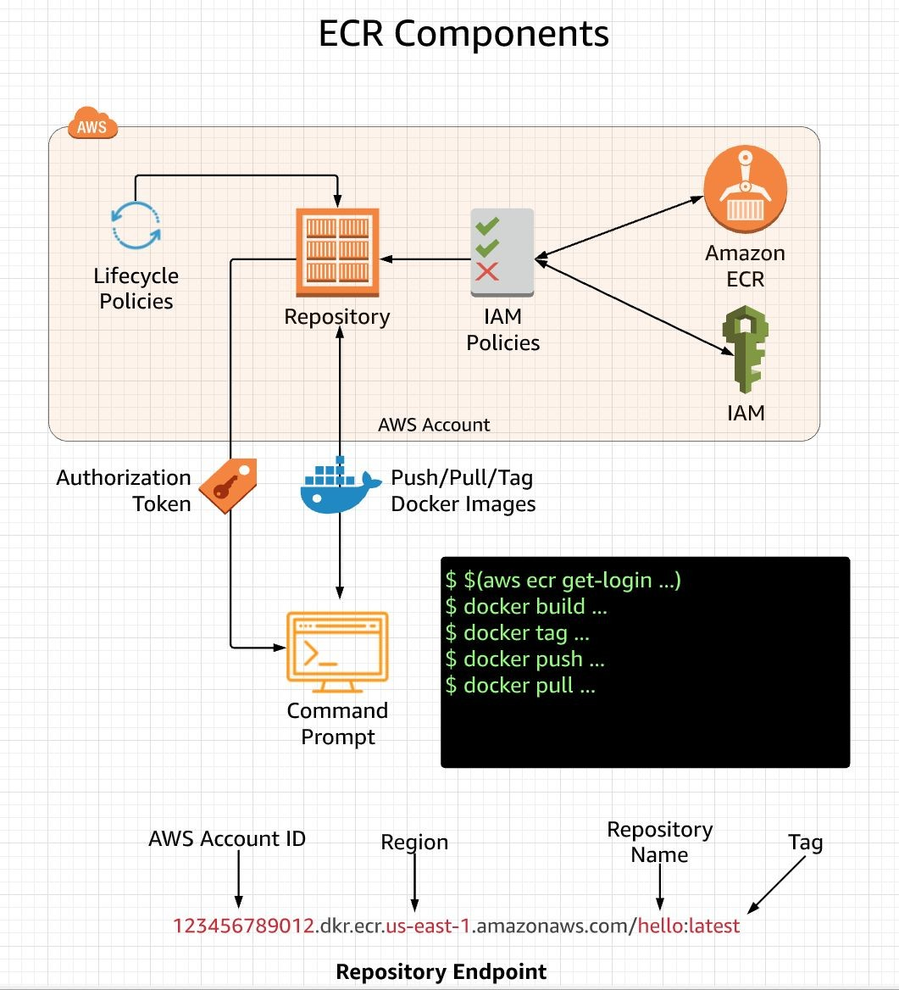
Publish Image to AWS ECR
It’s just like Docker Hub, where we can push and Pull image and we can
use it with AWS ECR same way. To get the docker login and auto execute the login the command is:
aws ecr get-login-password --region <region name> | docker login --username AWS --password-stdin <account_id>.dkr.ecr.us-west-2.amazonaws.com
E.g aws ecr get-login-password --region us-west-2 | docker login --username AWS --password-stdin 123456789012.dkr.ecr.us-west-2.amazonaws.com
After this create a ECR repo from AWS Management console, it will give a url like Showing in right side diagram, after that tag
The image: (All command are already given in AWS ECR UI, just use the same)
docker tag cicd-demo:latest
123456789012.dkr.ecr.us-west-2.amazonaws.com/ecs-cicd-demo:latest
docker push
123456789012.dkr.ecr.us-west-2.amazonaws.com/ecs-cicd-demo:latest
Make sure you use the right tags

Slide 14
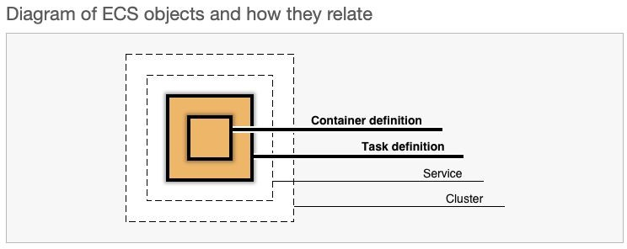
AWS ECS Key Concepts
Cluster :An ECS cluster is a grouping of (container) instances* (or tasks in Fargate) that lie within a single region, but can span multiple Availability Zones – it’s even a good idea for redundancy. When launching an instance (or tasks in Fargate), unless speciﬁed, it registers with the cluster named “default”. If “default” doesn’t exist, it is created. You can also scale and delete your clusters.
Agent: The Amazon ECS container agent is a Go program that runs in its own container within each EC2 instance that you use with ECS. (It’s also available open source on GitHub!) The agent is the intermediary component that takes care of the communication between the scheduler and your instances. Want to register your instance into a cluster? (Why wouldn’t you? A cluster is both a logical boundary and provider of pool of resources!) Then you need to run the agent on it.
Task: When you want to start a container, it has to be part of a task. Therefore, you have to create a task ﬁrst. Succinctly, tasks are a logical grouping of 1 to N containers that run together on the same instance, with N deﬁned by you, up to 10. Let’s say you want to run a custom blog engine. You could put together a web server, an application server, and an in-memory cache, each in their own container. Together, they form a basic frontend unit.
Task deﬁnition : Ah, but you cannot create a task directly. You have to create a task deﬁnition that tells ECS that “task deﬁnition X is composed of this container (and maybe that other container and that other container too!).” It’s kind of like an architectural plan for a city. Some other details it can include are how the containers interact, container CPU and memory constraints, and task permissions using IAM roles.
Then you can tell ECS, “start one task using task deﬁnition X.” It might sound like unnecessary planning at ﬁrst. As soon as you start to deal with multiple tasks, scaling, upgrades, and other “real life” scenarios, you’ll be glad that you have task deﬁnitions to keep track of things!
Service : To ensure that you always have your task running without managing it yourself, you can create a service based on the task that you deﬁned and ECS ensures that it stays running. A service is a special construct that says, "at any given time, I want to make sure that N tasks using task deﬁnition X1 are running." If N=1, it just means "make sure that this task is running, and restart it if needed!" And with N>1, you’re basically scaling your application until you hit N, while also ensuring each task is running.

Slide 15
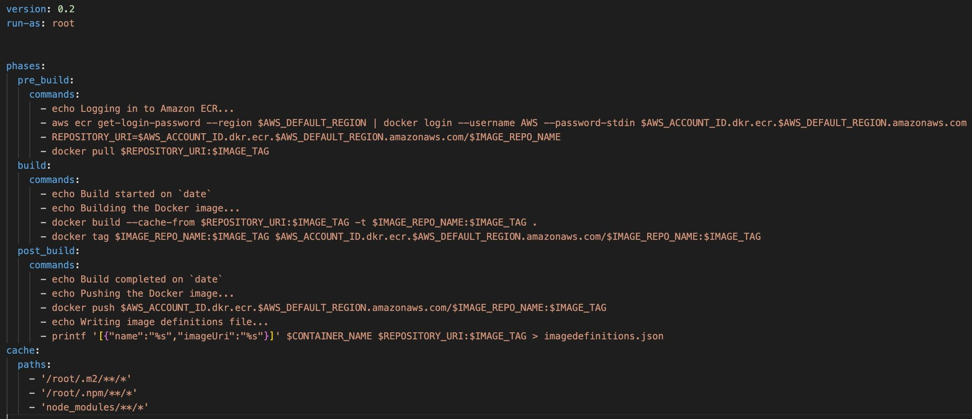
Lets Setup the Pipeline
We will be creating one AWS Pipeline project e.g. ecs-cicd-demo
Then Conﬁgure AWS CodeCommit as source and then using AWS CodeBuild
We will make Build and Deploy changes in AWS ECS Cluster Service using imagedeﬁnations.json
While Conﬁguring AWS CodeBuild , make sure to set the build spec ﬁle properly and to enter the required environment variables as follow:
AWS_DEFAULT_REGION AWS_ACCOUNT_ID IMAGE_REPO_NAME CONTAINER_NAME IMAGE_TAG
Also add, AWS ECS access Policy to the build project role

Slide 16





THANK YOU

